Slide 1
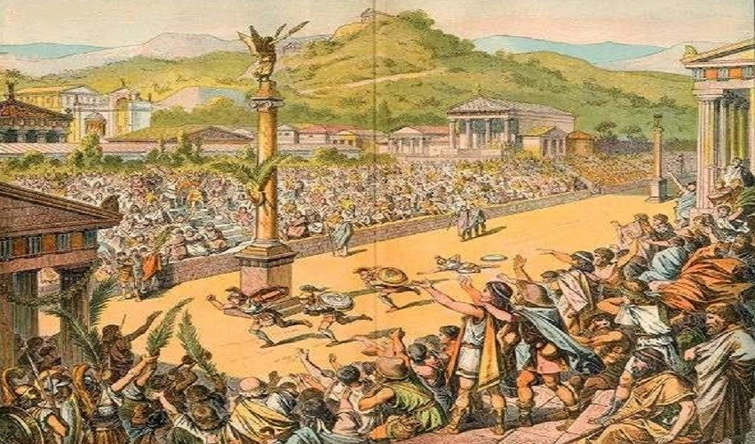
Computing
We will be learning how to explore and navigate key software this half term, through a range of games and challenges using each software.
French
We will be practicing speaking and listening in French, by learning greetings and goodbyes, as well as classroom instructions
Maths
We will be focusing on multiplicative reasoning, geometric reasoning and number sense.
PSHE/RSE
Our big question for PSHE this half term is ‘Is there such thing as a normal family?’, in which we will explore families and people who care for us.
PE
Hockey and Football
We will focus on Hockey and Football this half term, by following the rules of the games and playing fairly, maintaining possession of a ball with our feet and with a hockey stick, passing to teammates at appropriate times, leading others and how to act as a respectful team member.
Ancient Greece
What were the greatest achievements of Ancient Greece?
English
Non-chronological report
We will be learning about non-chronological reports this half term, focusing on the text-specific features and writing about mythological creatures.
Greek myths and plays
We will be learning about the myth of Daedalus and Icarus this half term, in which we will be immersing ourselves in the text through drama and artifacts, as well as writing our own Greek-inspired myth.
Inquiry
Our inquiry will be focused on Ancient Greece by discussing what we know and what we want to find out, looking into the history and greatest achievements of the Ancient Greeks, and creating our own Ancient Greek-inspired inventions.
RE
We will be learning about Christianity this half term, striving to answer the question, ‘What do Christians learn from the creation story?’
Music
We will be learning to read and perform Music, by reviewing and improving our own performances to deliver ‘A Shining Performance.’
Science
We will be investigating materials this half term. We will focus on the three states of matter, to answer the question, ‘Can materials change state?’

