Slide 1
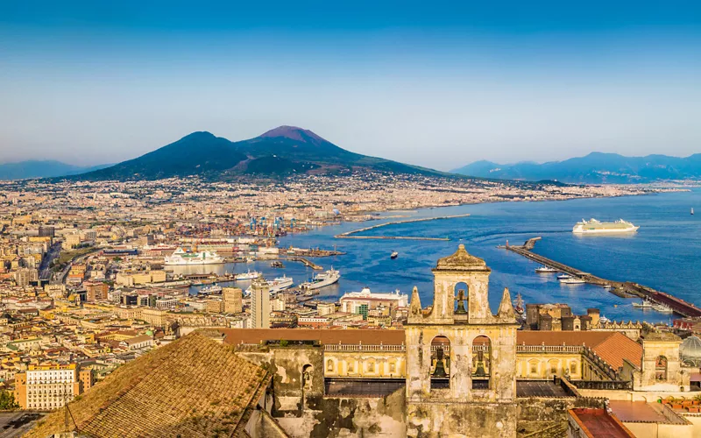
PE
Gymnastics and Cricket
We will focus on Gymnastics and Cricket this half term. We will be practicing different movements, techniques and balances in Gymnastics, while practicing catching, throwing, fielding and batting in Cricket.
PSHE
We will be learning about being safe this half term, by learning about physical and social boundaries, what permission looks like and answering the question, ‘How can we keep ourselves and others safe?’
Maths
We will be focusing on number sense, multiplicative reasoning and geometric reasoning this half term.
French
We will be learning about families in French this half term.
Cornwall My Home
What are the similarities and differences between Cornwall and Campania, Italy?
Inquiry
We will be learning about the geography of the region of Campania, Italy. We will be identifying human and physical features of this region and comparing them to human and physical geography in Cornwall.
Computing
We will be extending our understanding of different software this half term, focusing on how to effectively use Google Slides and Google Docs.
English
Recount - Diary
We will be learning about how to write diaries this half term, while focusing on the text-specific features and writing a diary about experiences in Pompeii.
Setting description
We will be learning about setting descriptions texts this half term, focusing on the text-specific features and writing about the eruption of Mount Vesuvius.
RE
We will be learning about Christianity this half term, striving to answer the question, ‘What kind of world did Jesus want?’
Music
We will be learning to enjoy improvisation in Music this half term by learning, improvising and performing songs using glockenspiels.
Science
We will be investigating living things this half term, by delving into classification, understanding habitats and how to protect them.

