Slide 1
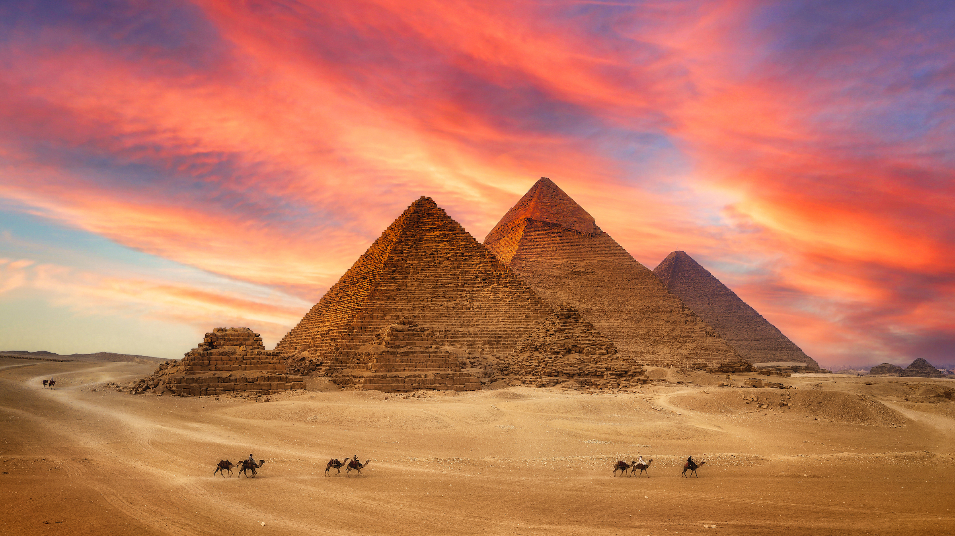
Maths
We will be focusing on number sense and additive reasoning this half term.
PSHE/Computing
Our big question for PSHE this half term is ‘Why are some games/content age restricted?’
PE
Dance and Swimming
We will focus on Dance and Swimming this half term. We will be practicing different movements, techniques and sequences in Dance, while practicing different strokes, distances and techniques in Swimming.
French
We will be practicing reading and writing in French, focusing on going to school and in the classroom.
English
Narrative – Setting Description
We will be writing setting descriptions this half term, learning the text-specific language features and writing our own setting descriptions about an Ancient Egyptian tomb.
Persuasive leaflet
We will be writing persuasive leaflets this half term, learning the text-specific language features and writing our own leaflets about visiting Ancient Egypt.
Ancient Egypt
What were the greatest achievements of Ancient Egypt?
RE
We will be learning about Hinduism this half term, striving to answer the question, ‘What does it mean to be a Hindu in Britain today?’
Music
We will be learning to perform Music this half term, focusing on recycling songs.
Science
We will be learning to understand and investigate materials this half term. We will focus on rocks and soils, answering ‘How can we classify rocks?’
Inquiry
Our inquiry will be focused on Ancient Egypt by discussing what we know and what we want to find out, looking into the history of Ancient Egypt and its achievements, and making our own tools inspired by those used during this period.

