Slide 1
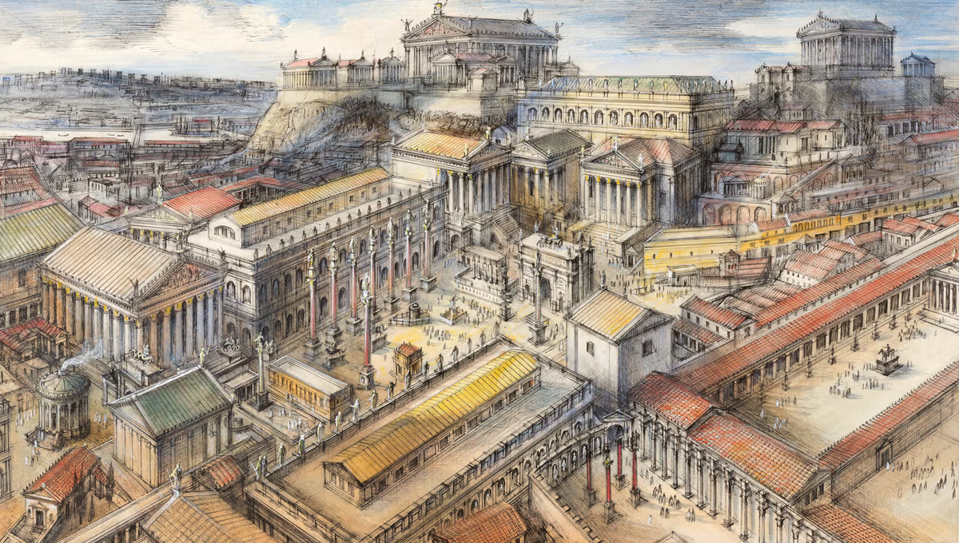
PE
Swimming and Dance
We will focus on Dance and Swimming this half term. We will be practicing different movements, techniques and sequences in Dance, while practicing different strokes, distances and techniques in Swimming.
Computing and PSHE
We will be learning about online safety this half term, by delving into what risks to be aware of and how to use the internet safely, and answering the question, ‘How do I recognise risk online?’
Maths
We will be focusing on number sense and additive reasoning this half term.
French
We will be learning about colours in French and numbers from 20 to 50 this half term.
Ancient Rome
How did the Ancient Romans impact Britain?
English
Recount – science experiment
We will be learning about how to conduct a science experiment this half term, while focusing on the text-specific features and writing about our own experiments using cress.
Characterising speech
We will be learning about characterising speech texts this half term, focusing on the text-specific features and writing about Boudicca vs the Romans.
Inquiry
History
Our inquiry will be focused on Ancient Rome by establishing what we already know and what we wonder about the Ancient Romans, and delving into their history in Britain to answer the question, ‘How did the Ancient Romans impact Britain?’
DT
We will be mastering practical skills in DT by making Ancient Roman biscuits within our Inquiry.
RE
We will be learning about Christianity this half term, striving to answer the question, ‘What is it like to follow God?’
Music
We will be learning to perform Music this half term by learning and performing the song ‘Three Little Birds’ using our voices and instruments.
Science
We will be learning about the features and functions of plants and striving to answer the question, ‘How does each part of a plant fulfil its function?’

