Slide 1
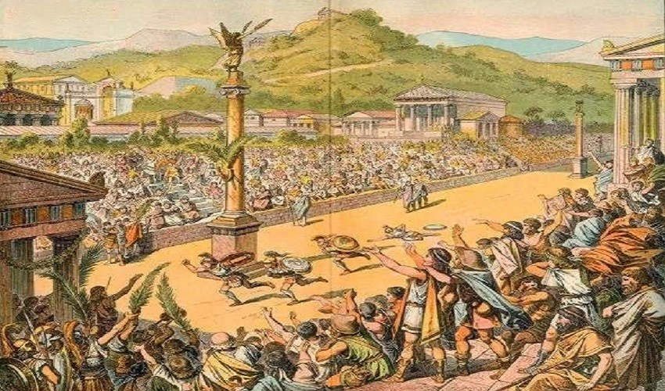
Computing and Art
We will be learning to draw using pencils and on iPads this half term, learning to sketch and to draw Ancient Greek mythical creatures on Procreate – a digital art tool.
French
We will be learning the letters of the alphabet and numbers from 0 to 20 in French this half term.
Maths
We will be focusing on multiplicative reasoning, geometric reasoning, number sense and additive reasoning.
PSHE/RSE
Our big question for PSHE this half term is ‘Should I always trust my friends?’, in which we will explore the dynamics of friendships and the importance of building and respecting trust.
PE
Basketball and Rugby
We will focus on Basketball and Rugby this half term, by following the rules of the games and playing fairly, maintaining possession of a ball with our hands, passing to teammates at appropriate times, dribbling, shooting, leading others and how to act as a respectful team member.
Ancient Greece
What were the greatest achievements of Ancient Greece?
English
Recount - letter
We will be learning about recount letters this half term, focusing on the text-specific features and writing about our own adaptation of an Ancient Greek myth.
Instructions
We will be learning about instructions texts this half term, focusing on the text-specific features and writing about how to slay an Ancient Greek mythical creature.
RE
We will be learning about Judaism this half term, striving to answer the question, ‘How do festivals and family life show what matters to Jewish people?’
Music
We will be learning to perform Music this half term by practicing and performing the songs in our Christmas production.
Inquiry
Our inquiry will be focused on Ancient Greece by learning about human and physical features of geography. We will be asking and answering questions about the human and physical characteristics of Ancient Greece, as well as explaining our own views of Ancient Greece and its features.
Science
We will be understanding light and seeing this half term, striving to answer the question, ‘What is light?’

