Slide 1
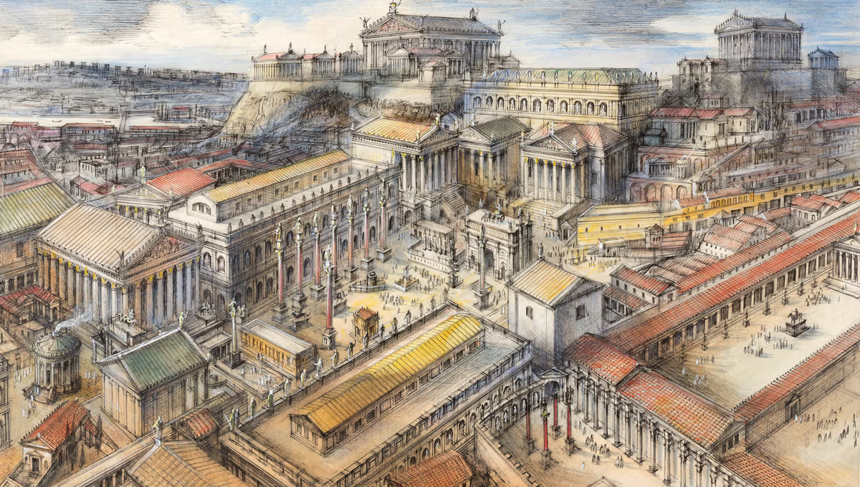
PE
Swimming and Tennis
We will focus on Tennis and Swimming this half term. We will be practicing different movements, techniques and strikes in Tennis, while continuing to practice different strokes, distances and techniques in Swimming.
Computing and PSHE
We will be learning about respectful relationships this half term, by delving into what respect is and how to establish respect and boundaries within relationships, and answering the question, ‘What is respect and how is earned?’
Maths
We will be focusing on number sense, multiplicative reasoning and geometric reasoning this half term.
French
We will be learning about dates and birthdays, as well as different food in French this half term.
Ancient Rome
How did the Ancient Romans impact Britain?
Inquiry
Art
We will be making Roman-inspired mosaics using coloured paper and glue within our Inquiry this half term.
Geography
We will be learning about human and physical features of geography. We will be asking and answering questions about the human and physical characteristics of Ancient Rome in the UK, as well as explaining our own views of Ancient Rome and its features.
English
Persuasive letters
We will be learning about how to write persuasive leaflets this half term, while focusing on the text-specific features and writing a letter to persuade someone to watch a spectacle in the Colosseum.
Character description
We will be learning about character description texts this half term, focusing on the text-specific features and writing about a Roman Emperor.
RE
We will be learning about Islam this half term, striving to answer the question, ‘How do festivals and worship show what matters to a Muslim?’
Music
We will be learning to compose with our friends in Music this half term by learning, performing and composing different pieces of music together.
Science
We will be learning to understand movement, forces and magnets, and striving to answer the question, ‘How do magnets work?’

