Slide 1
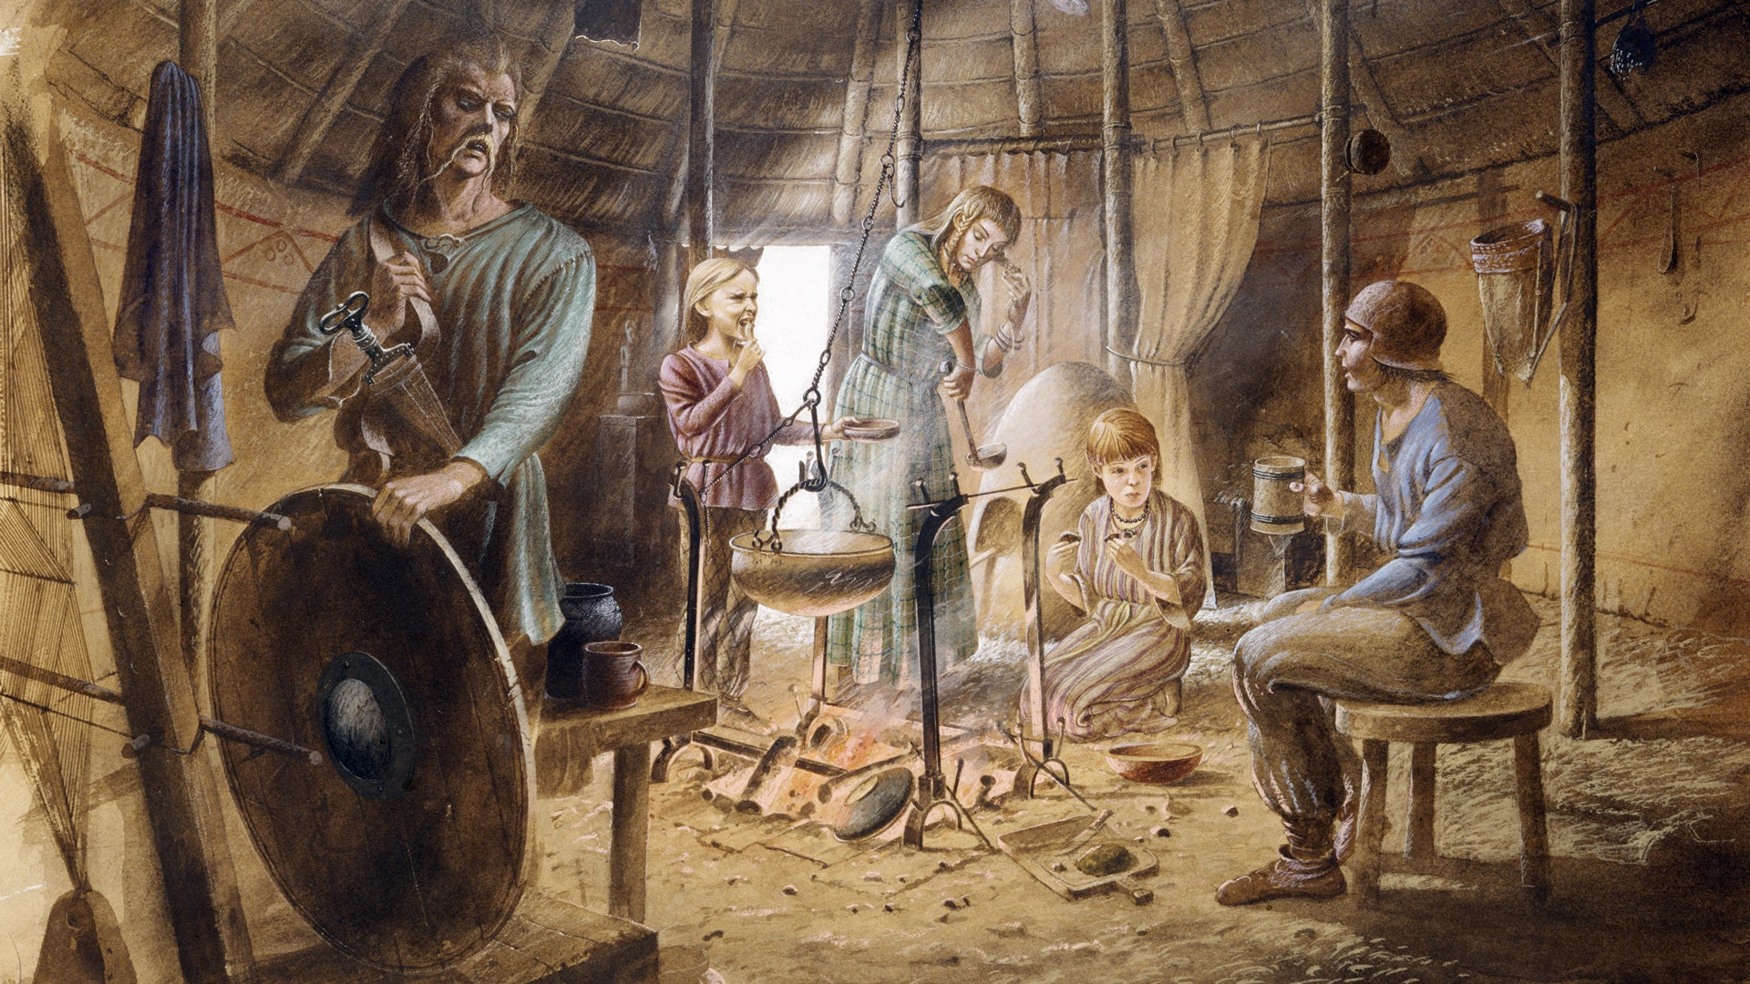
Maths
We will be focusing on multiplicative reasoning, geometric reasoning and number sense.
PSHE/RSE
Our big question for PSHE this half term is “Why do I worry and is it natural? How can I manage my emotions?"
PE
Basketball and Rugby
We will focus on Basketball and Rugby this half term, by following the rules of the game and playing fairly, maintaining possession of a ball with our hands, passing to teammates at appropriate times, and leading others and act as a respectful team member.
Computing
We will be learning to how to use Seesaw, research online and create slideshows to showcase our learning.
French
We will be practicing speaking and listening in French, by learning classroom instructions and the French alphabet.
Stone Age to Iron Age
How did daily life in Britain change from the Stone Age to the Iron Age?
Inquiry
Our inquiry will be focused on the Stone Age and Iron Age by discussing what we know and what we want to find out, looking into the history of the transition from the Stone Age to the Iron Age, and painting our own Paleolithic cave paintings.
English
Narrative – story
We will be writing our own short stories about the Stone Age.
Recount – letter
We will be writing a recount letter about the Stone Age.
RE
We will be learning about Christianity this half term, striving to answer the question, ‘What is trinity?’ and learning about Christmas.
Music
We will be learning to perform and describe Music.
Science
We will be learning to understand animals and humans this half term. We will focus on systems of the human body, answering ‘How do the systems inside our body work to make a healthy human?’

