Slide 1
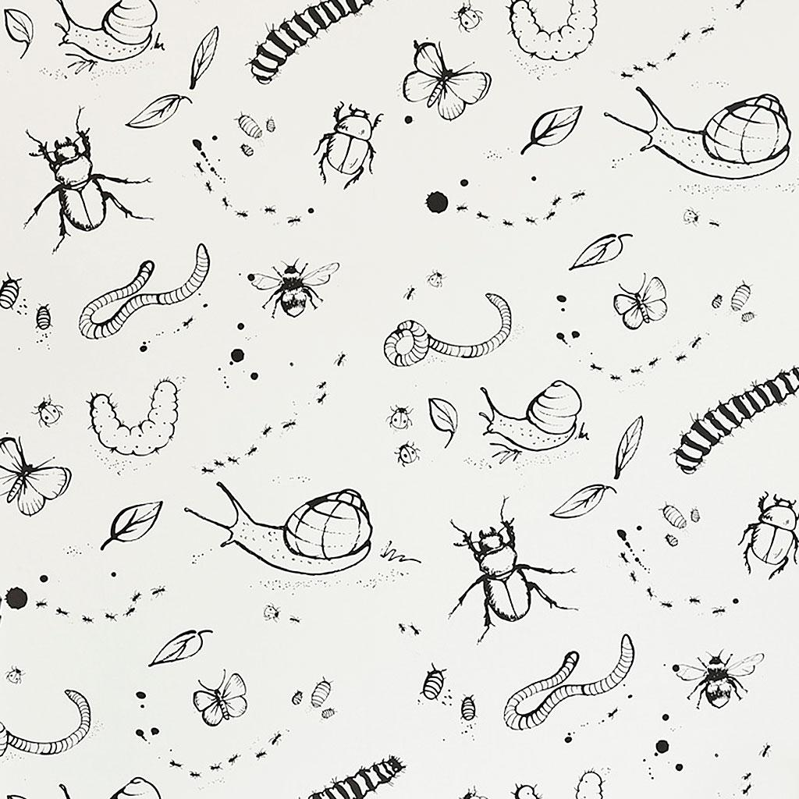
English
Our English will be interwoven with Inquiry as we explore the world of mini beasts.
We will be learning how to write non-chronological reports, using formal language and fascinating facts to inform our readers. We will also be writing a narrative based on the story ‘The Bad Tempered Ladybird’, as well as crafting lots of lovely autumnal poetry.
We will share the magic of high-quality poetry, non-fiction and stories daily during our ‘poem-before-play’ and ‘story time sessions.
Maths
Our focus in the first half term will be on number sense and additive reasoning; particularly on securing our understanding of place value and our grasp of mathematical language. We will use a variety of manipulatives and a mixture of indoor and outdoor activities to ensure we can apply this understanding across a range of scenarios.
Inquiry
During our inquiry into minibeasts, we will be learning many scientific skills such as asking questions, hypothesising, carrying out simple tests, observing, categorising and recording findings. We will learn about the basic needs of living things, life-cycles, food-chains, and the importance of biodiversity. We will be broadening our scientific vocabulary to ensure we have the appropriate language to explore and describe the world around us. We will be using new skills learnt in Art to represent biodiversity in a creative way.
We will be using new DT skills to design, create and evaluate an edible item.
Minibeasts
Key Stage 1
Capturing biodiversity through creativity
PE
Our focus this term will be on developing a variety of multi-skills such as agility, strength, coordination and balance. We will then be applying these skills while learning how to play football.
Music
We will be having fun making a lot of noise listening to and describing Rimsky-Korsakov’s ‘Flight of the Bumblee’, singing minibeast songs and practising for our Harvest Festival.
PSHE/RSE
We will be settling into our new classes, establishing a welcoming environment and a love of learning.
RE
We will be learning about Christianity and the creation of the world from a Christian perspective. We will also be learning about harvest.
ICT
We will use ICT throughout Inquiry to investigate, explore and represent our learning, while considering how to stay safe online.

