Slide 1
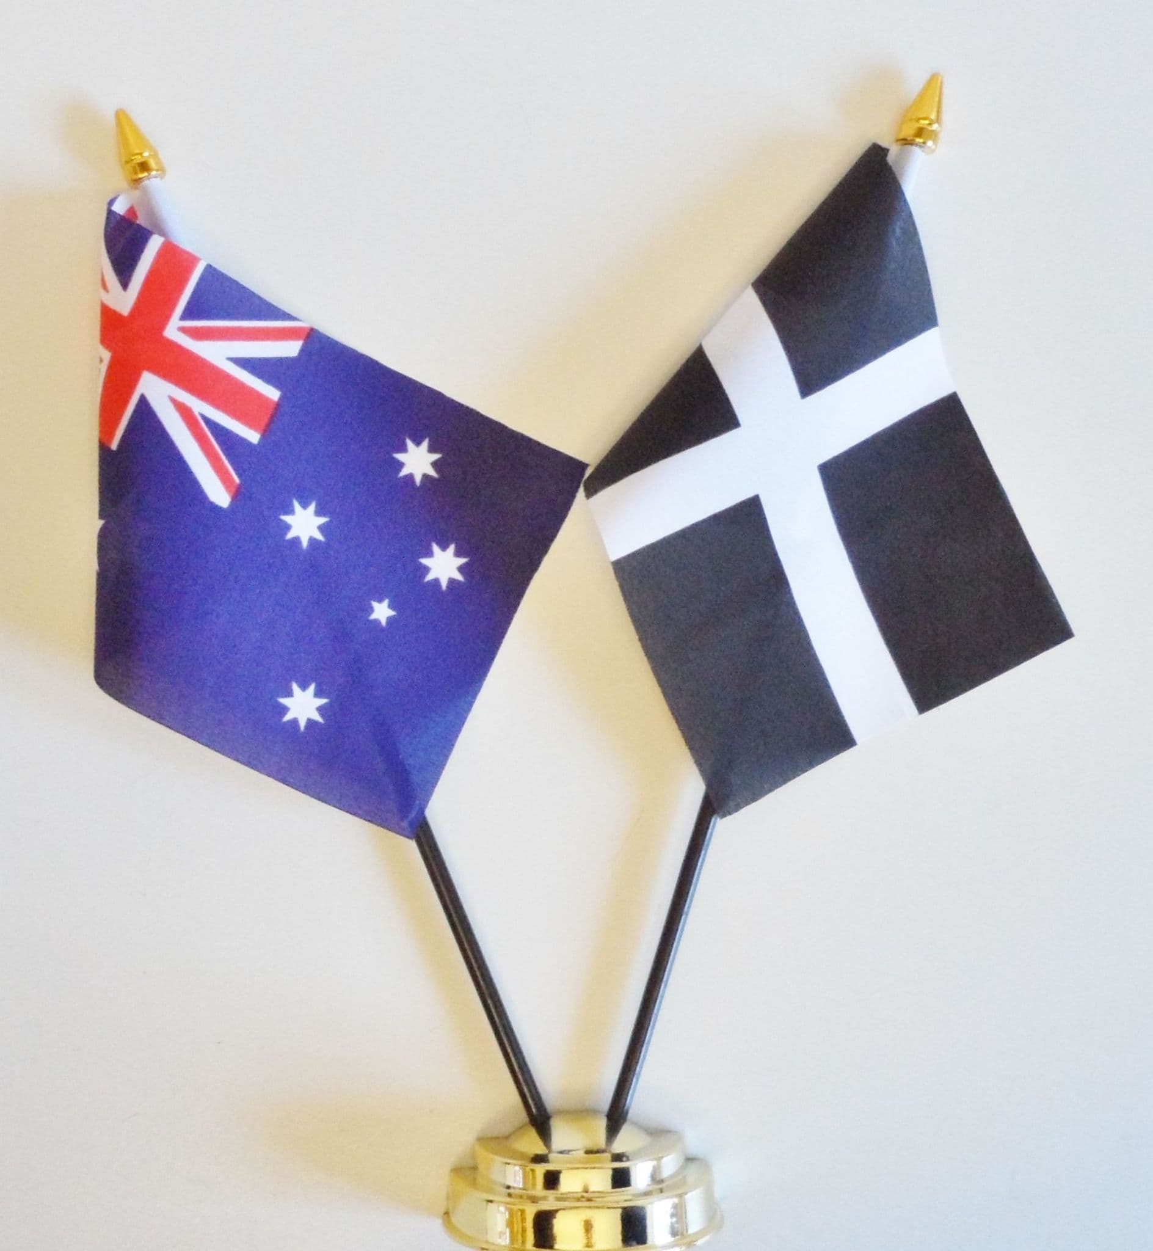
Maths
We will be focusing on additive reasoning and multiplicative reasoning. Following our main four operations of addition, subtraction, multiplication and division.
PSHE/RSE
Our big question for PSHE this half term is ‘Why am I changing?’ and ‘Why is the world changing?’
PE
Rounders and Athletics
We will be learning the rules for rounders and thinking about batting, catching, throwing and fielding. We will be using our athletics lessons to practice for sports day.
French
We will be learning to read and write whilst following different things we may find at a farm.
Cornwall My Home
How do physical characteristics vary between Cornwall and Australia?
English
Narrative (Character descriptions)
We will be focusing on the language features required to write a character description and writing our own descriptions about a creature/being from Southern Australia.
Narrative (full)
We will also be writing our own stories based on what we have learned from our Cornwall My Home topic.
RE
We will be learning about Cornwall and answering the question: ‘How and why do people in Cornwall mark significant events in community life?’
Music
We will be learning to perform Music this half term, focusing on Cornwall My Home and South Australia.
Science
We will be focusing on the process of Scientific Investigations this half term and completing our own investigations by understanding and following this process.
Inquiry
Our inquiry will be focused on Cornwall and Australia. We will be looking into Aboriginal art and printing.
We will also be following the design process to make our own ocean-themed pulleys.

