Slide 1
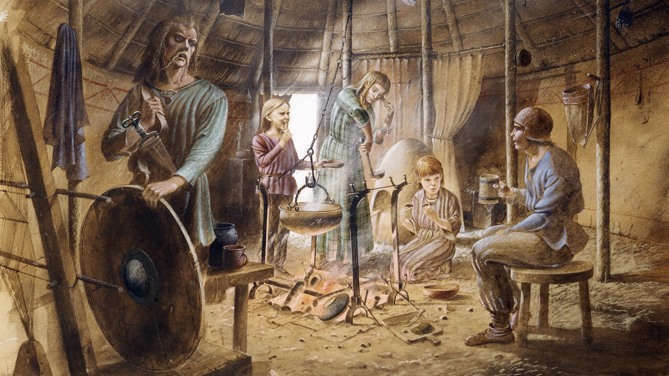
Computing
We will be learning to how to use Seesaw, research online and create presentations to showcase our learning.
French
We will be practicing speaking and listening in French, by learning about being at home and about pets.
Maths
We will be focusing on multiplicative reasoning, additive reasoning and number sense.
PSHE/RSE
Our big question for PSHE this half term is ‘What are the benefits of physical fitness on our mental health?’
PE
Football and Hockey
We will focus on Football and Hockey this half term, by following the rules of the game and playing fairly, maintaining possession of a ball, passing to teammates at appropriate times, and leading others and acting as a respectful team member.
Stone Age to Iron Age
How did daily life in Britain change from the Stone Age to the Iron Age?
English
Place Value of Punctuation and Grammar​
We will be revisiting punctuation and grammar this half term, learning about the position of word types and punctuation to form accurate and effective sentences.
Non-chronological report
We will be learning about non-chronological reports texts this half term, focusing on the text-specific features and writing about prehistoric creatures.
RE
We will be learning about Hinduism this half term, striving to answer the question, ‘What do Hindus believe God is like?’
Music
We will be learning about playing in a band in Music this half term.
Science
We will be learning to understand animals and humans this half term. We will focus on systems of the human body, answering ‘How do the systems inside our body work to make a healthy human?’
Inquiry
Our inquiry will be focused on the Stone Age and Iron Age by discussing what we know and what we want to find out, looking into the history of the transition from the Stone Age to the Iron Age, and painting our own Palaeolithic cave paintings.

