Slide 1
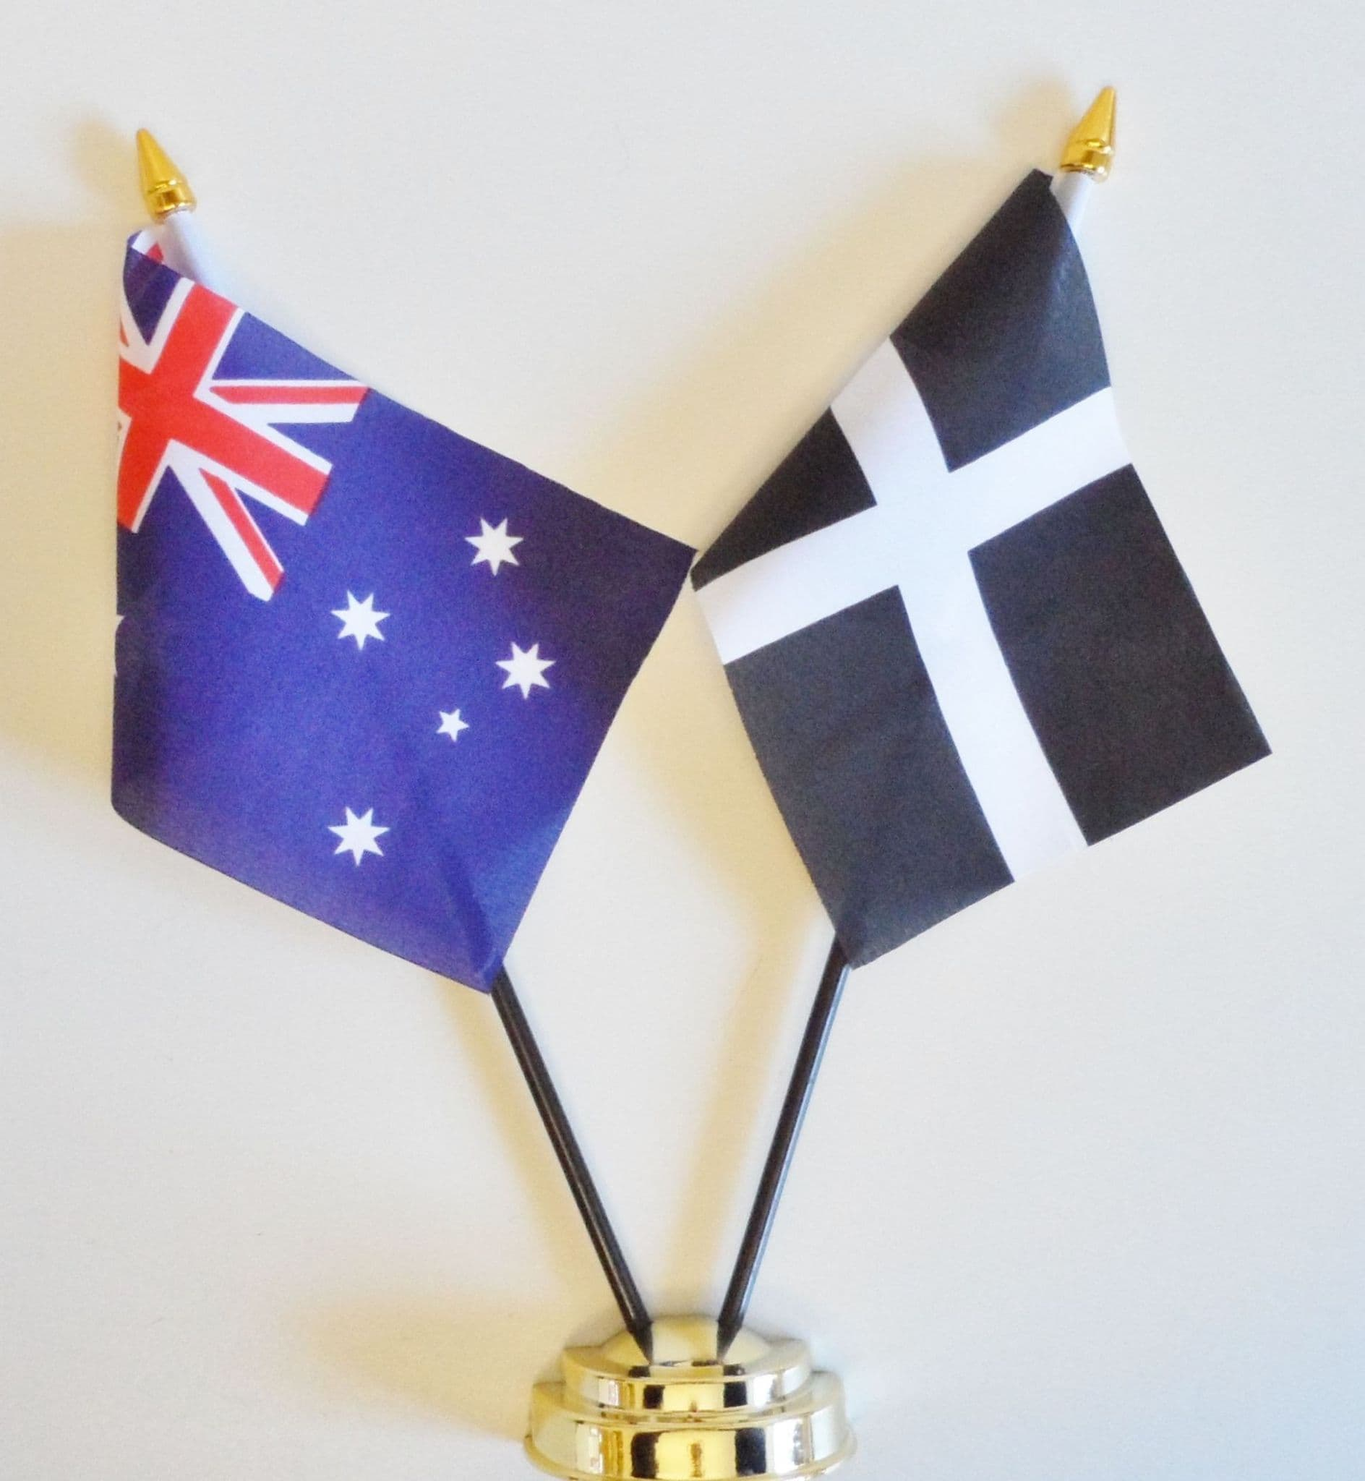
Computing
We will be learning to code this half term, by developing our understanding of Scratch and using our drawing skills to design characters and backgrounds.
French
We will be learning about the weather and seasons.
Maths
We will be focusing on geometric reasoning and number sense this half term.
PSHE/RSE
Our big questions for PSHE this half term are ‘Why do we need to be protected from the sun?’ and ‘Why is sleep important?’
PE
Tennis and Athletics
We will focus on Tennis and Athletics this half term. We will be practicing forehand, backhand, juggling and movement in Tennis, and practicing for sports day in athletics.
Cornwall My Home
How do physical characteristics vary between Cornwall and Australia?
English
Recount - Diary
We will be writing diaries this half term, learning the text-specific language features and writing our own diaries as a Cornish tin miner.
Recount - Biography
We will be writing biographies this half term, learning the text-specific language features and writing our own biographies.
RE
We will be learning about Christianity this half term, striving to answer the question, ‘When Jesus left what was the impact of Pentecost?’
Music
We will be learning to use sound effects to enhance the drama and realism of a film clip.
Science
We will be learning to investigate living things in Science this term. We will be completing class projects on the effects of environmental change.
Inquiry
Our inquiry will be focused on Cornwall by discussing what we know and what we want to find out, identifying different types of physical geography, and comparing physical geography features in Cornwall to those in southern Australia.

