Slide 1
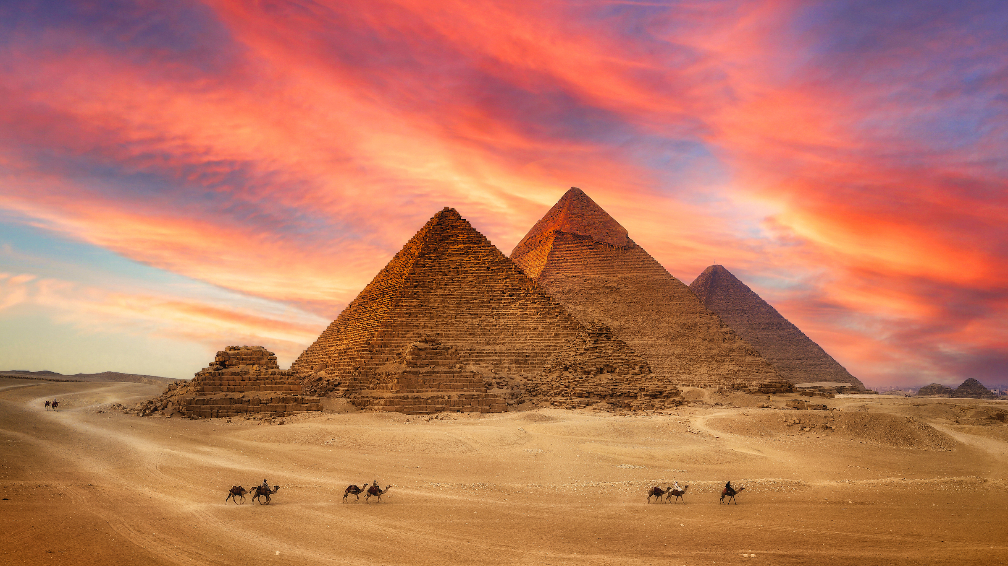
Maths
We will be focusing on number sense, multiplicative reasoning and geometric reasoning.
PSHE/RSE
Our big question for PSHE this half term is: ‘What are calories and why are they important?’
PE
Gymnastics and Swimming
We will focus on Gymnastics and Swimming this half term. We will be practising different balances, movements and rolls in Gymnastics, while continuing to learn different strokes, distances and techniques in Swimming.
French
We will be practising speaking and listening in French, focusing on sports and hobbies, as well as different instruments.
Ancient Egypt
What were the greatest achievements of Ancient Egypt?
English
Characterising speech
We will be looking at how to correctly punctuate speech using the model text: ‘Egyptian Cinderella’.
Poetry
We will be exploring and learning how to write poetry, focusing on Kenning, Tetractys and Free Verse poems.
RE
We will be learning about Christianity this half term, striving to answer the question, Why do Christians call the day Jesus died ‘Good Friday’?
Music
We will be learning to explore musical contrasts in Music this half term, focusing on learning, singing and playing instruments.
Science
We will be learning and investigating sound and hearing. Trying to answer the question, ‘What is sound?’
Inquiry
Our inquiry will be focused on Ancient Egypt by sculpting our own death masks in Art. In DT, we will be looking at Ancient Egyptian food and then inquiring about the Human Geography aspects of Ancient Egypt.

